Slide 1
0HM280 Human-Robot Interaction
Raymond Cuijpers
Peter Ruijten
Armin Kohlrausch
Emilia Barakova

Slide 2
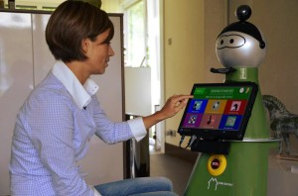
Current state-of-the-art
Mobiserv (EU FP7)
Main aim:
MOBISERV - An Integrated Intelligent Home Environment for the Provision of Health, Nutrition and Mobility Services to Older Adults Developing robots and smart devices to assist older people maintain active independent lives
http://www.mobiserv.info
https://www.youtube.com/watch?v=6DFJwnwzhPs&list=TLMBU0solEKYrvBjEgEaxPdDrdFfT8GBJi

Slide 3
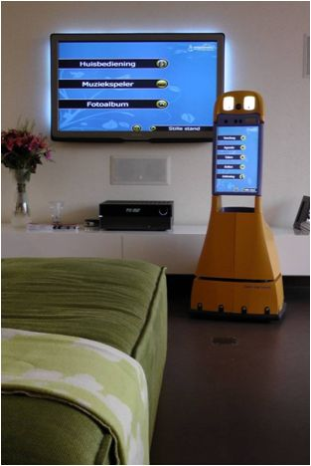
Current state-of-the-art
Companionable (EU FP7)
Main aim:
CompanionAble will provide the synergy of Robotics and Ambient Intelligence technologies and their semantic integration to provide for a care-giver's assistive environment. This will support the cognitive stimulation and therapy management of the care-recipient. This is mediated by a robotic companion (mobile facilitation) working collaboratively with a smart home environment (stationary facilitation).
http://www.companionable.net/
Field test in Smart Homes NL
https://www.youtube.com/watch?v=yQFFQ2FvjUY

Slide 4
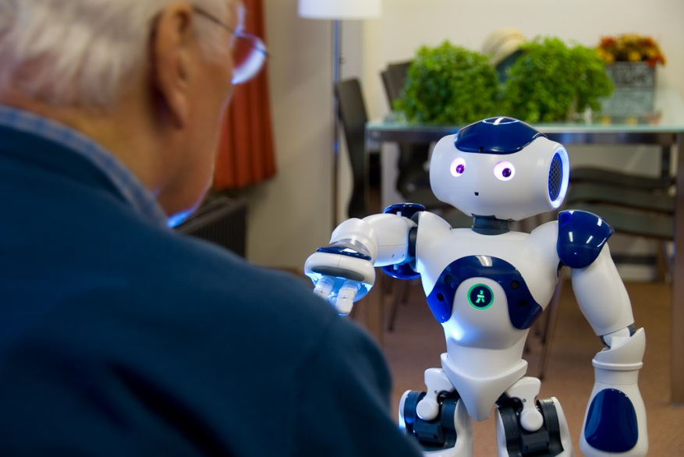
Current state-of-the-art
KSERA (TU/e, EU FP7)
Main aim:
Socially Assistive Robot (SAR) that helps older persons, especially those with Chronic Obstructive Pulmonary Disease (COPD), with their daily activities and care needs and provides the means for effective self-management of their disease.
www.ksera-project.eu
Prototype 1
https://www.youtube.com/watch?v=eIZrj-M4w64
Prototype 2
https://www.youtube.com/watch?v=Y776gWW4Bys

Slide 5
REsearch
Progress beyond state of the art

Slide 6
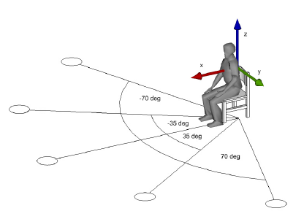
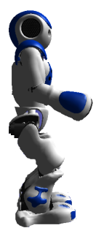
Methods: Personal space model
10 Participants (16-51 years) mean age 24
3 Tasks
5 Directions
3 Repetitions per task
Notes:
Personal robots that share with humans the same environment need to be socially acceptable and effective when interacting with the environment as well as the users.
One of the trait that caracterizes user’s perception of the robot is

Slide 7
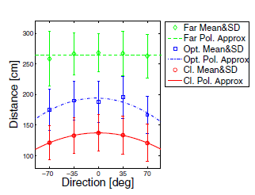
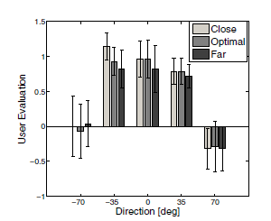
Approaching humans for communication
Judged distance:
Far, Near and Optimal
Model for optimal distance
User rating:
Left, middle and right
Model for optimal direction
Notes:
Personal robots that share with humans the same environment need to be socially acceptable and effective when interacting with the environment as well as the users.
One of the trait that caracterizes user’s perception of the robot is

Slide 8
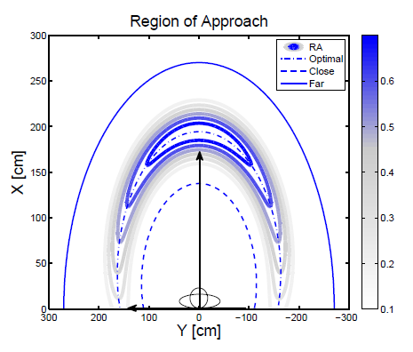
Bayesian Model
The target location is modeled as a probability distribution over the space around the user:

Slide 9
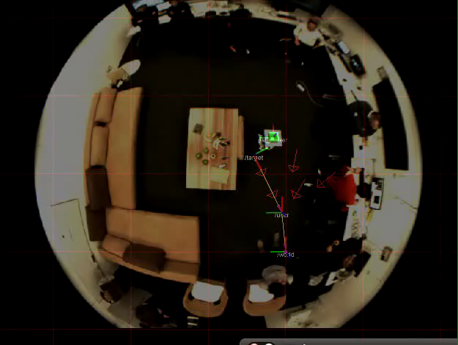
Personal Space
Notes:
Personal robots that share with humans the same environment need to be socially acceptable and effective when interacting with the environment as well as the users.
One of the trait that caracterizes user’s perception of the robot is

Slide 10
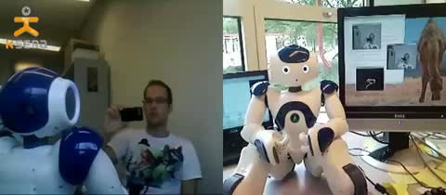
Eye contact
Eye contact
A social convention that shows when someone is paying attention
Feasability/Timing of interaction
Delivering a message is only useful when person is attending
Natural behaviour
Facilitates understanding and improves user acceptance

Slide 11
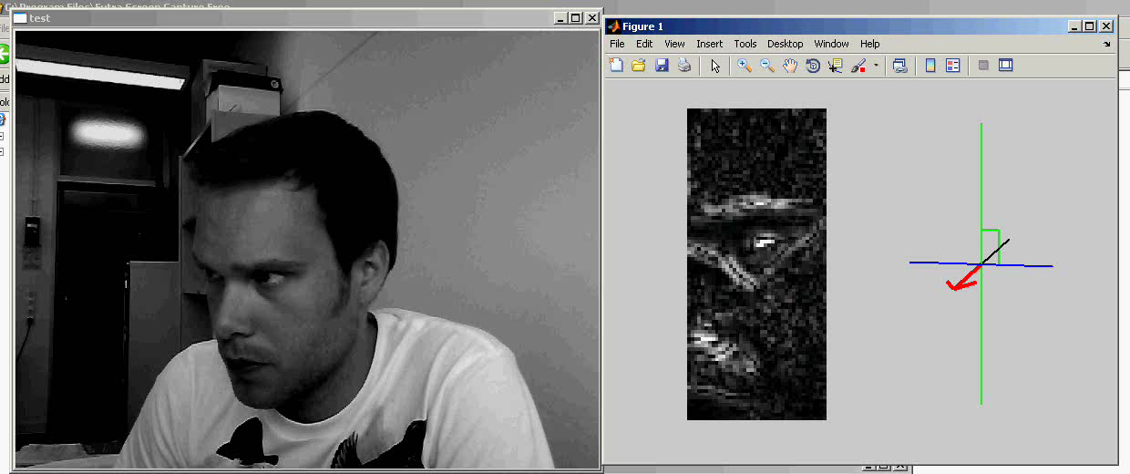
Head Pose Estimation
Head pose estimation allows the robot to judge whether a person is looking at it
Transformed frame (input)
Pose (output)
Camera stream

Slide 12
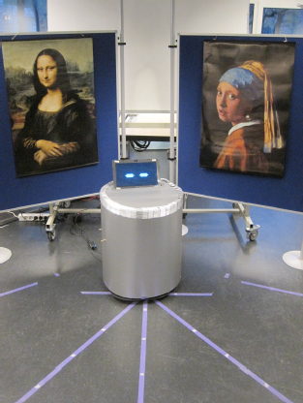
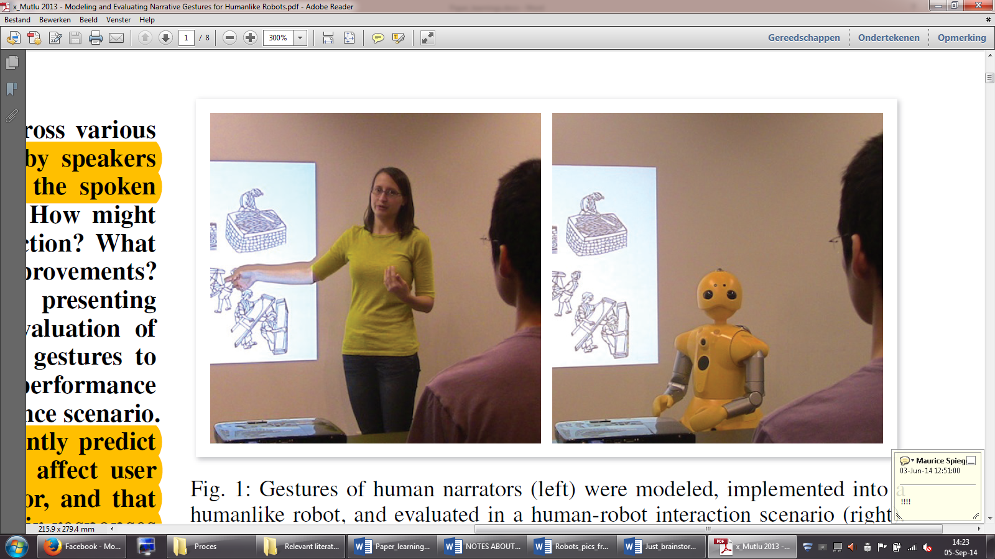
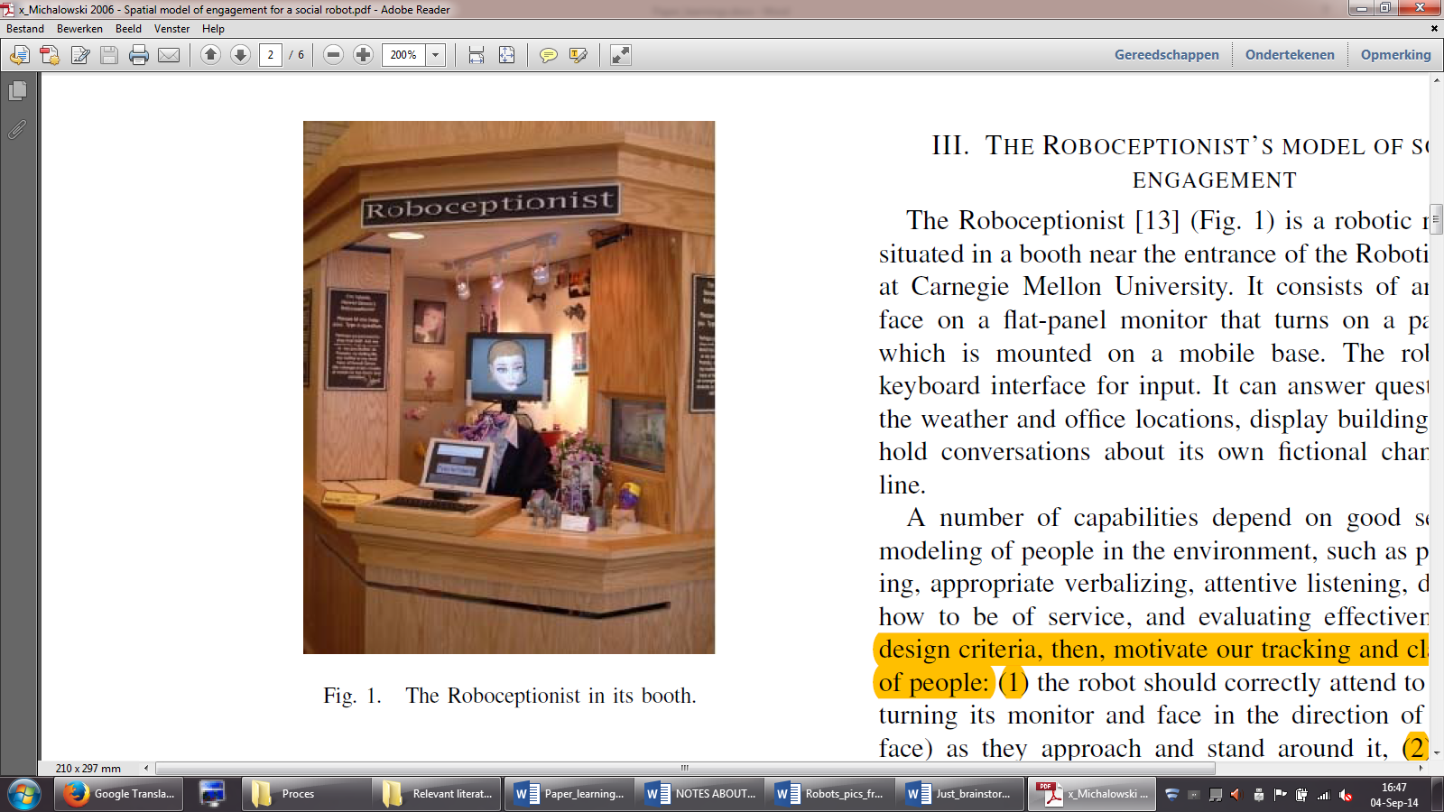
Turn-taking and Eye Contact
Robotic systems deployable for information exchange services
Museum tour-guide
Lecturer
Receptionist
Karreman et al. 2013
Huang & Mutlu, 2013
Michalowski, 2006
of 32
Notes:
Instead of manufacturing robots in industry → Social robots that facilitate people
Employability of interactive robotic systems is expected to emerge in environments which are based on information exchange services
And as you can see, the prototypes above can differ significantly from each other:
Garbage-can on wheels that can talk, NO limbs
We evaluated the effects of robot gaze behavior on
interactions with multiple users in a museum-like setting. We
posit that a robot needs to divide its attention between multiple
users and may be able to use its gaze to ‘point’ at objects of
interest.
Robot with more human-like FACIAL characteristics and ARMS for body gestures
A robotic AGENT with VIRTUAL appearances, fixed position

Slide 13
Turn-taking and Eye Contact
To engage in a multiparty conversation the robot must be able to detect:
who is addressing whom
who “has the floor”
when a conversation has ended
when a conversation may be interupted
how to deal with non-speaking persons
...
Good software and models are still missing

Slide 14
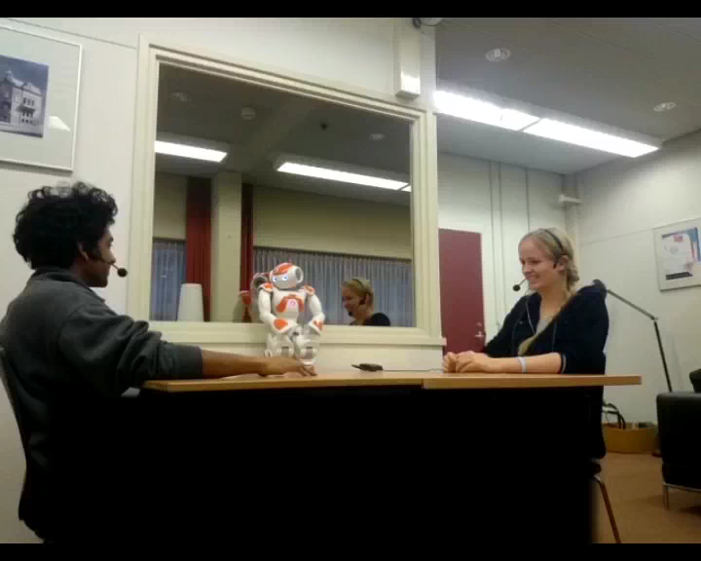
Turn-taking and Eye Contact
1. Conservative turn take behavior
of 32
Notes:
Inform the audience about:
That participants get the time to say things, and can easily finish their sentences.
The robot is a good listener and it takes turn when the participants are silent

Slide 15
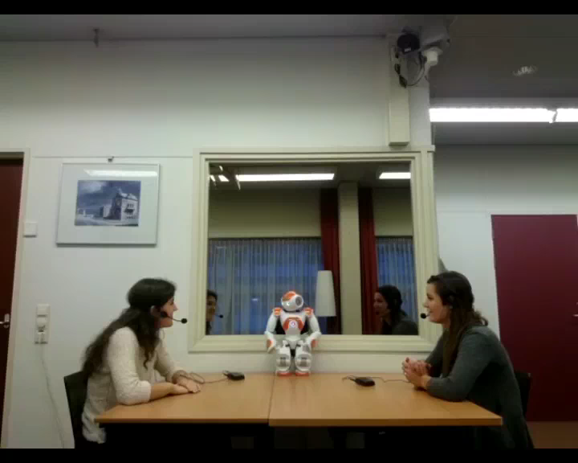
Turn-taking and Eye Contact
3. Adaptive turn take behavior
of 32
Notes:
Inform the audience about:
The robot doesn’t wait for silence and gets triggered when looked-upon
As a result participants get interrupted, causing misunderstandings and the feeling of being ignored

